Slide 1
Forward in Christ

Slide 2
Our Goals
To help readers grow in faith so they can live a Christian life.
To provide a deeper look and a personal perspective on Christian life and challenges.
To inform members what’s going on in WELS
To nurture a sense of being a part of something bigger than the local church
Broaden the information, insights, and perspectives our people receive from their local congregation

Slide 3
Most Important
To assist pastors and congregations
Our Recent Survey of Readers
Asked for reaction from readers, lapsed readers, and non -readers
Excellent Response
Evaluate Content
Explore Distribution
Evaluate Subscriptions Procedures

Slide 4
Forward in Christ Gets High Marks!
59% of readers are are highly satisfied
A majority score the magazine in the “great” range.
79% look forward to the next issue.
90% are likely to renew.

Slide 5
Readers respond:
Easy to read and understand
Keeps me up to date
Provides an opportunity to learn
Is visually interesting

Slide 6
Why They Read FIC
To stay in informed of what’s going on within WELS
To grow and be motivated in their Christian faith.

Slide 7
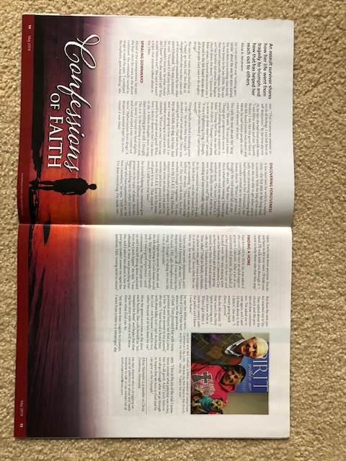
“Confessions of Faith” is the most liked feature.
Devotions are a close second..

Slide 8
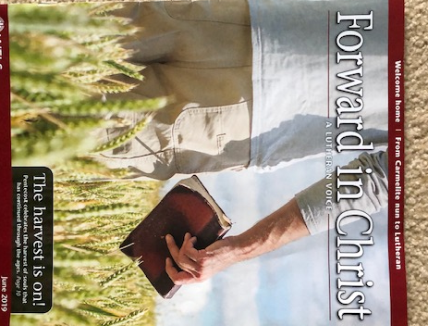
We ask for your continued support. Subscribe! Congregations! Individuals!

